Slide 1

Hyperledger
Technical Working Group China
2022.6

Slide 2

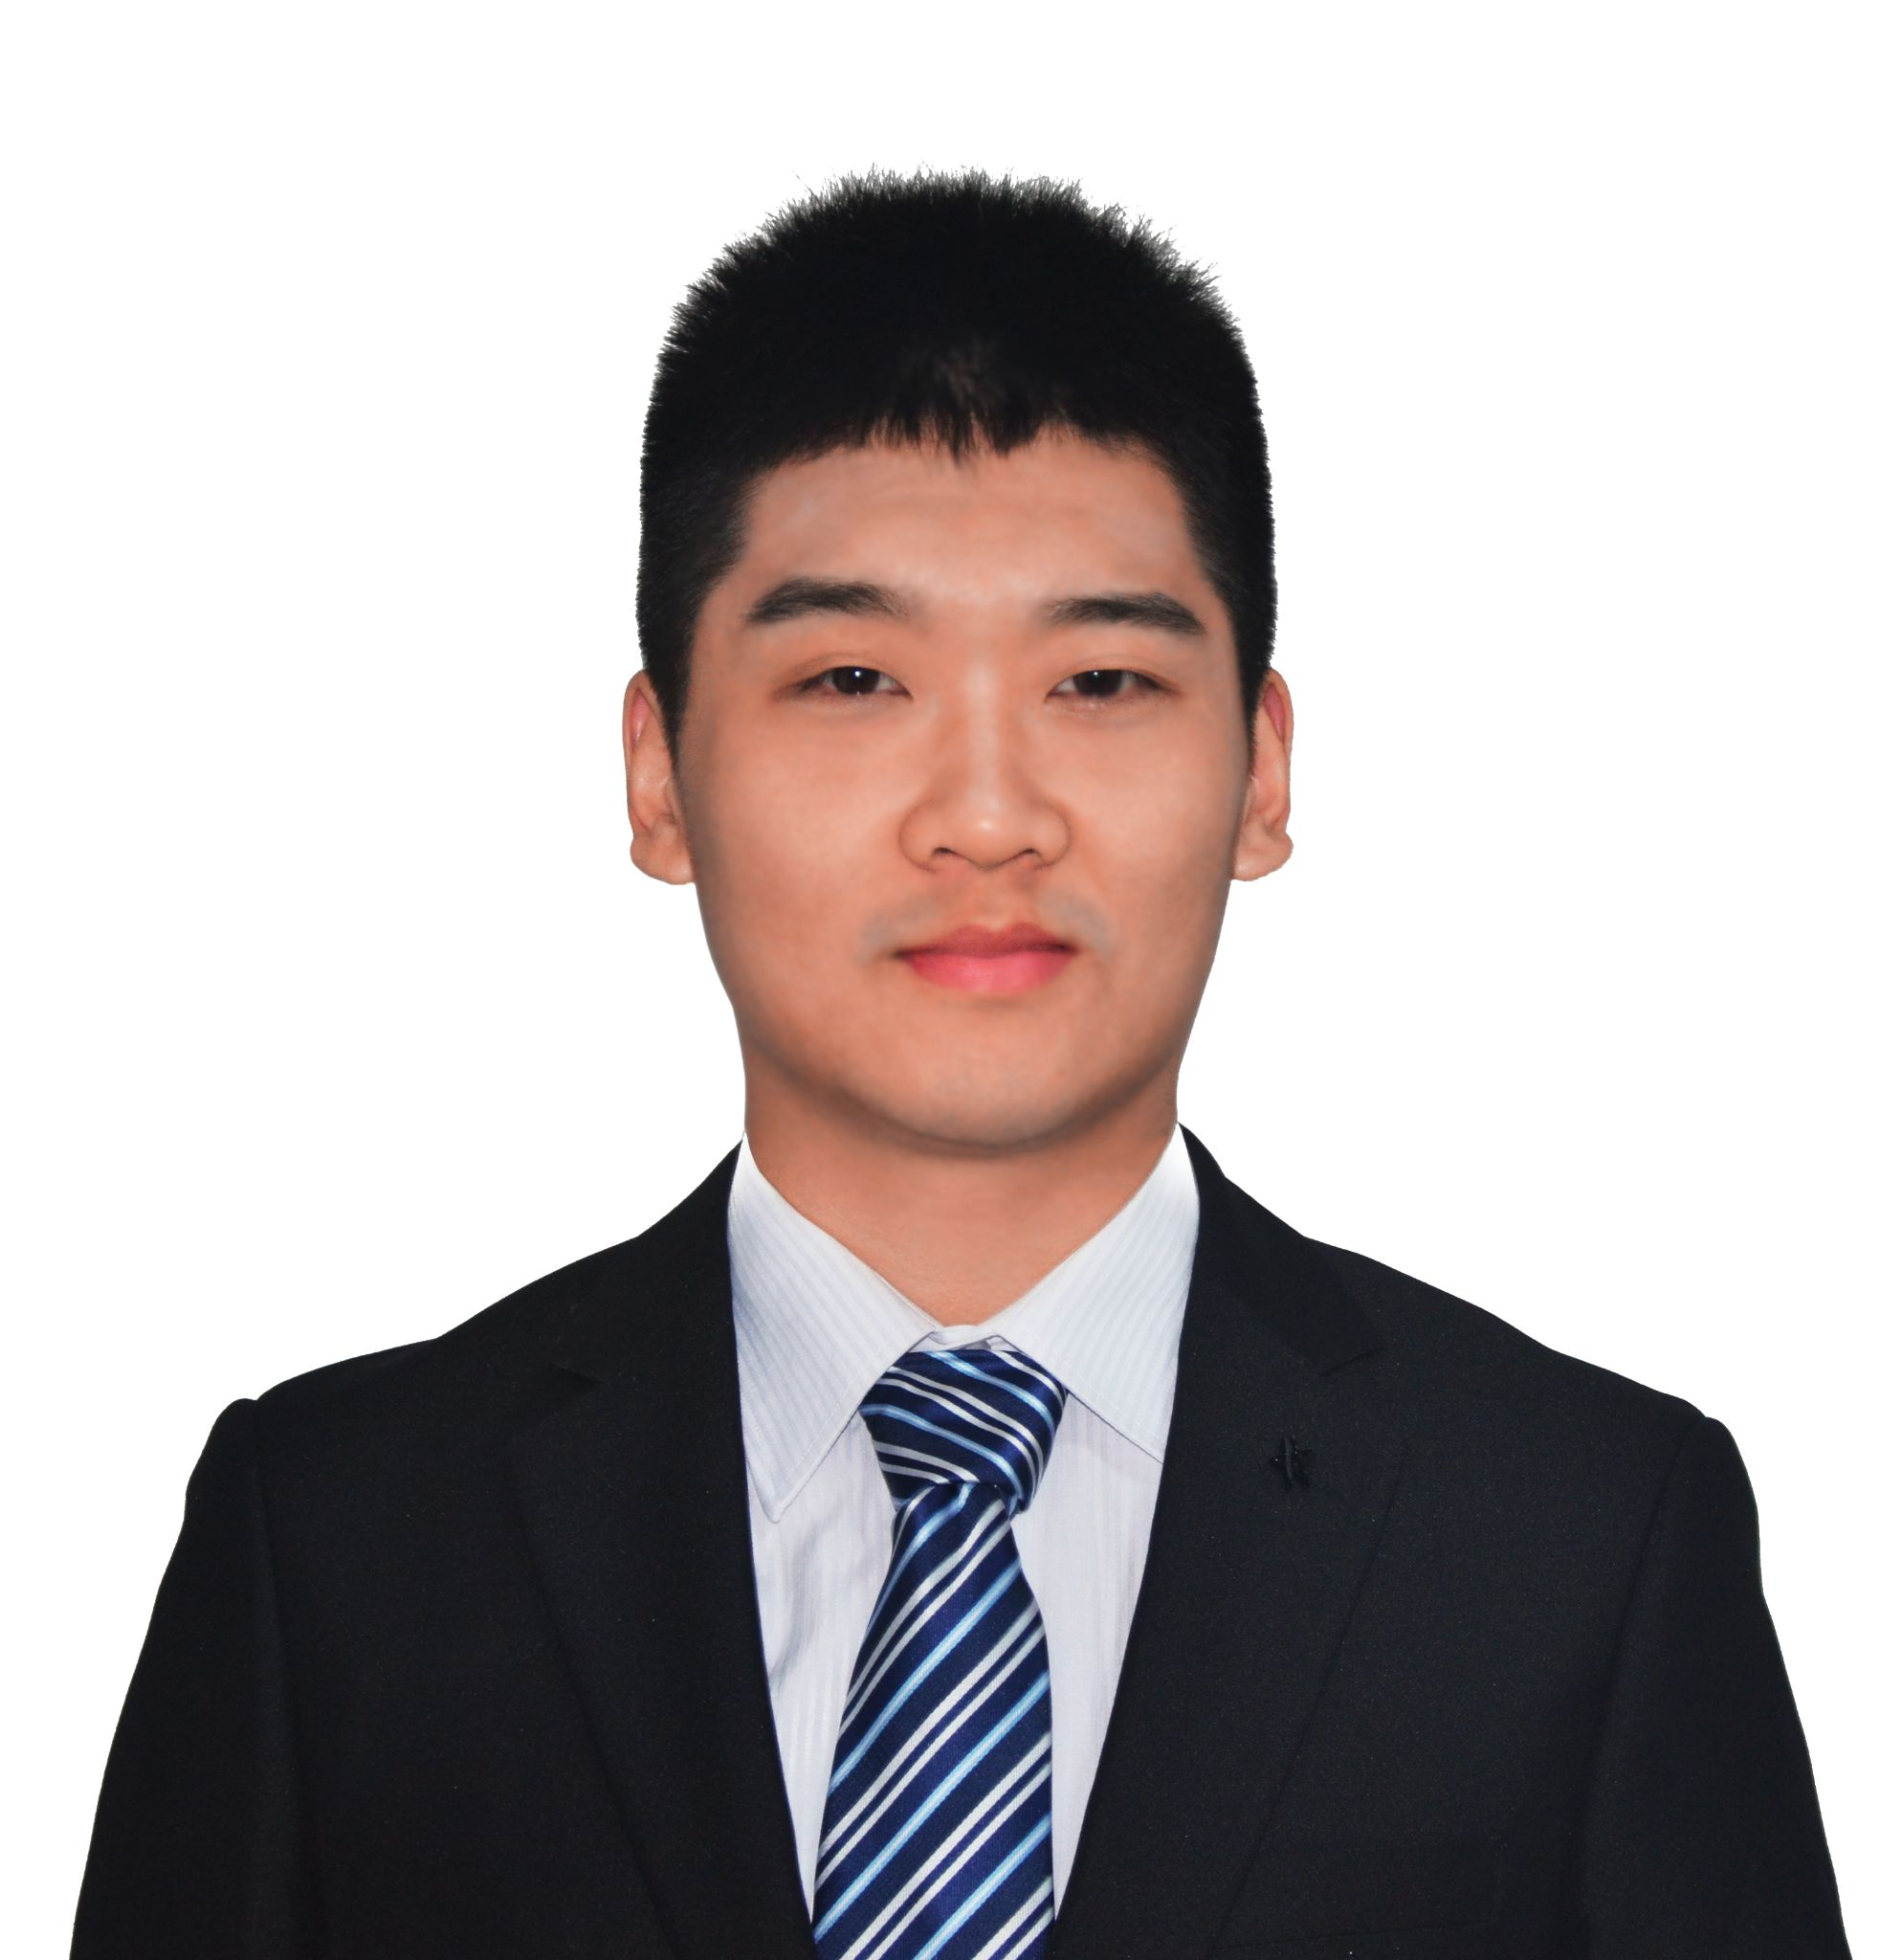
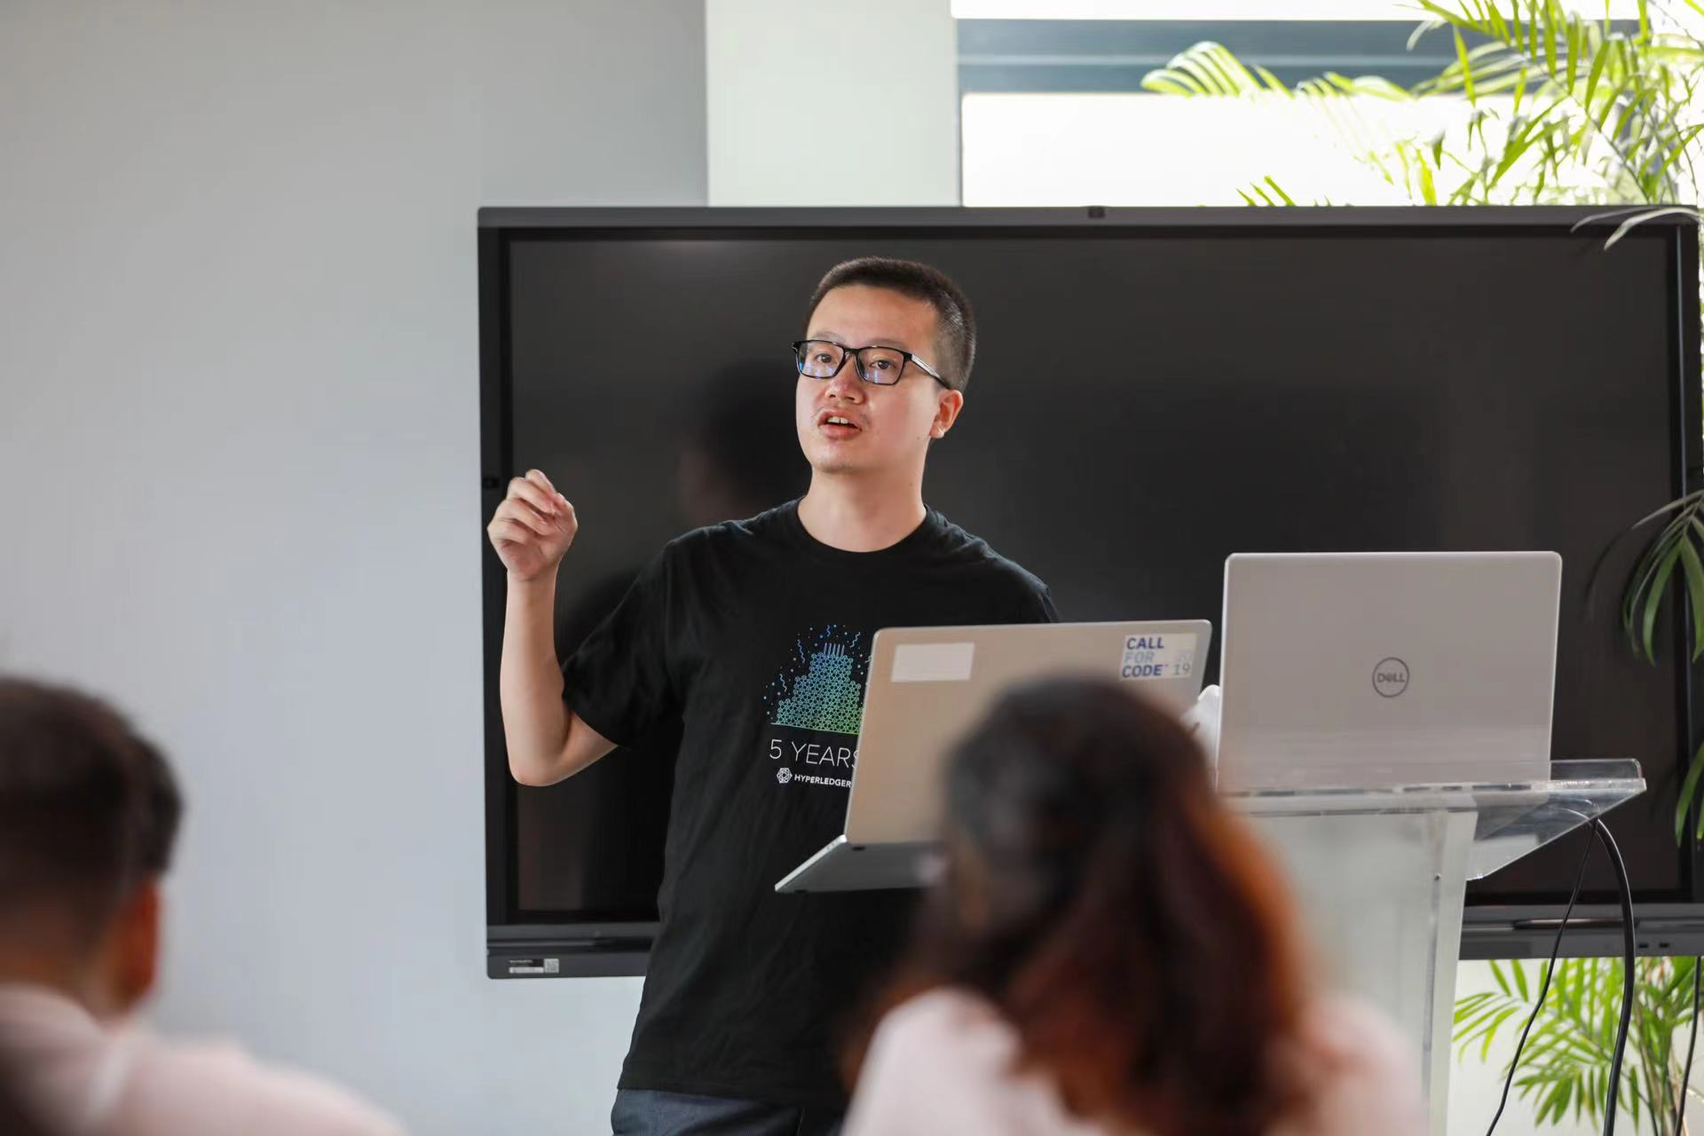
中国技术工作组TWGC
连接中国社区与国际社区的桥梁
TWGC联席组长 (2022)
2016年12月成立
双周三晚上例会 Bi-weekly Meeting
技术小组 Squads
国密组
性能组（已经与国际社区PSWG合并）
国际化与教育组 （Hyperledger的第一个i18n工作组）
联络方式：邮件列表/Rocket.Chat/微信群
刘宇翔 (David Liu)
Oracle 香港
程阳(Yang Cheng)
CAICT 北京
袁怿（Sam Yuan）
IBM 北京

Slide 3

Scope
Technical Working Group Chain(TWGC, 中国工作组) is the first region-based working group, TWGC is responsible for growing the Hyperledger developer community in China by responding to new user questions, helping with first-level triage of community-reported bugs or other issues, helping demonstrate to new developers how to report bugs or fire pull requests, and pointing motivated developers towards the project roadmaps and development initiatives at the global Hyperledger web sites. It should also make sure to expose new users to the broad range of projects at Hyperledger.

Slide 4

Communication
01 | Bi-weekly group meeting on Wednesday 20:00~21:00 (GMT+8)
02 | Maillist: twg-china@lists.hyperledger.org
03 | Rocketchat：https://chat.hyperledger.org/channel/twg-china
04 | Wiki: https://wiki.hyperledger.org/display/TWGC
05 | Wechat groups
06 | Code Collaboration: github.com/Hyperledger-TWGC

Slide 5


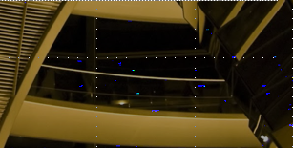
Working Areas
Localization & Education
Events Organization
01
Help lead the documentation writing/translation, organize seminar and education/trainings, etc.
03
Help instruct the events organization like meetup/hackathon
Development & Innovation
Collaborations & Scenarios
Help lead the development of hyperledger projects in code, tutorial, demos, with instructions on maillist, rocketchat, etc.
Help encourage the collaborations between organizations and projects, with landing more scenarios/apps
02
04

Slide 6
技术小组 Squad
TWGC下设面向特定主题的工作组
小组名称 | 目标 | 现状
性能优化小组 | 收集并分享超级账本项目性能优化方案，包括但不限于设计提案、论文、代码 讨论性能优化方案和实现验证，并反馈社区 讨论性能测试标准和方案 开发性能测试工具 | 性能优化脑图 性能测试工具tape与probe 博客与视频 PSWG合并，提出performancesandbox项目
国密改造小组 | 利用社区资源开发并维护Fabric国密版，减少重复造轮子 通过抽象接口，支持不同的密码库实现 | 基础库开发与维护 基础库互操作框架 完成Fabric 2.2改造poc SDK和CA国密改造 Modular crypto提案 workshop与wiki
国际化与教育小组 | 超级账本项目文档翻译 相关博客、文章翻译 提供翻译工具 制作发布教程和资料 | 已完成Fabric 1.4/2.2翻译 支持国际社区进行其他语言的本地化工作 已发布7个视频教程

Slide 7


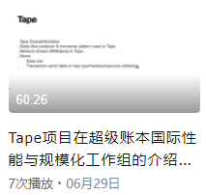

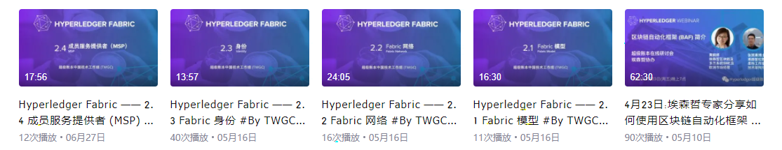
Event Organization
TWGC organizes meetups and webinars regularly

Slide 8
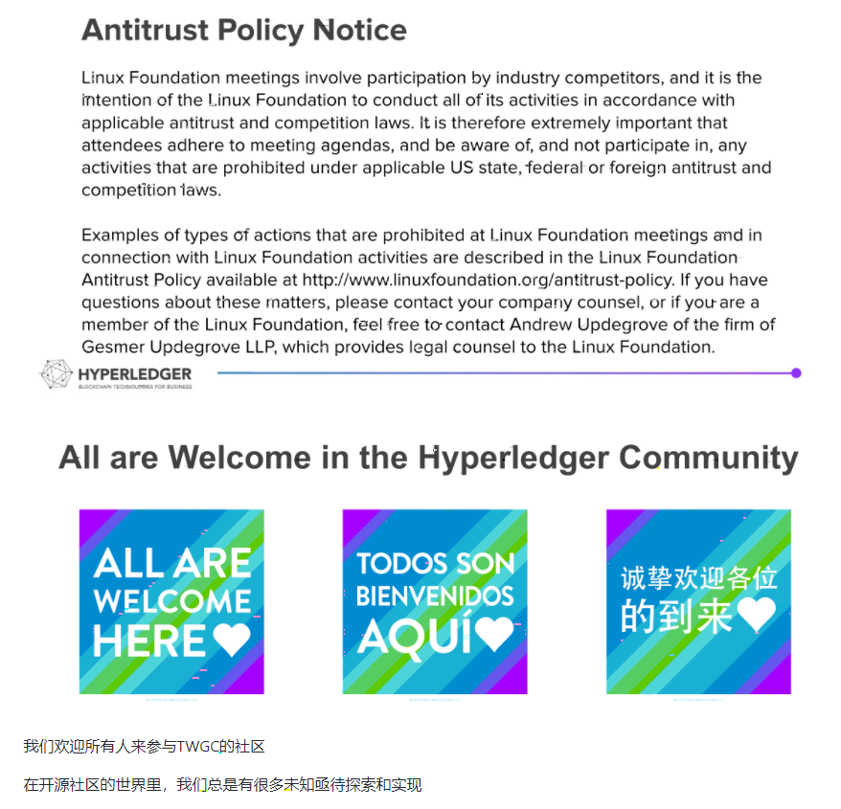
How to participate
All are Welcome!

Slide 9
Good first...
“Collaboration and Scenario”
Revive “Fabric interopt”: fabric conformance
Hyperledger +: cross domain use case
Proposal: CrossChain TaskForce
Revive “PSWG”
“Events Organization”
Proposal for next event
“Development & Innovation”
Show your support
All way Github #hyperledger-TWGC
Attend any TaskForce meeting and let us jam!
Donate project and incubating

Slide 10
Thank you.

